Slide 1

Rapport du Comité de Suivi Individuel
Young Jun Kim^{(1,2)}, David Le Touzé⁽¹⁾
(1) Ecole Centrale de Nantes, France, (2) Bureau Veritas, France
09th / 10 / 2019

Slide 2
General information
Affiliation
School : École Centrale de Nantes (ECN)
Lab : LHEEA
Team : H2I (Hydrodynamique, Interfaces et Interactions)
Date of admission
01/01/2018 (1 year 10 months)
Financement
CIFRE contract from Bureau Veritas (BV) and ECN
Encadrants de thèse
David Le Touzé (Directeur)
Benjamin Bouscasse (Co-encadrant)

Slide 3

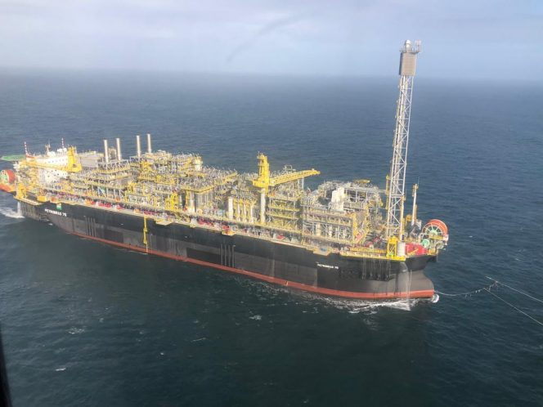
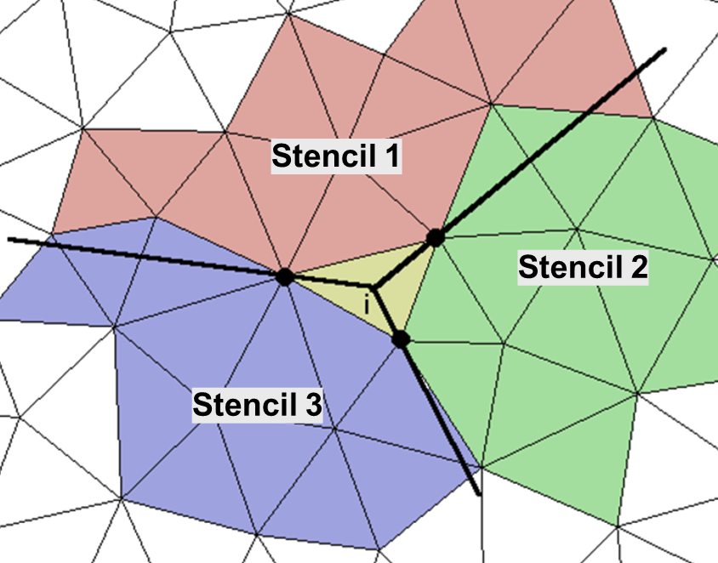
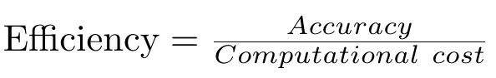
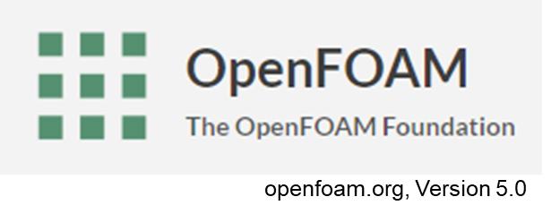
Objective
Numerical improvement and validation of a naval hydrodynamics CFD solver in view of performing fast and accurate simulation of complex ship-wave interaction.
Numerical Improvement
Efficiency
Naval applications
One of Petrobras’ FPSOs in Brazil; Source: Petrobras
Higher-order schemes?
Notes:
Tentative title
Do numerical improvement
Check its efficiency
Do real naval application with improved sovler.
CFD solver used is:

Slide 4
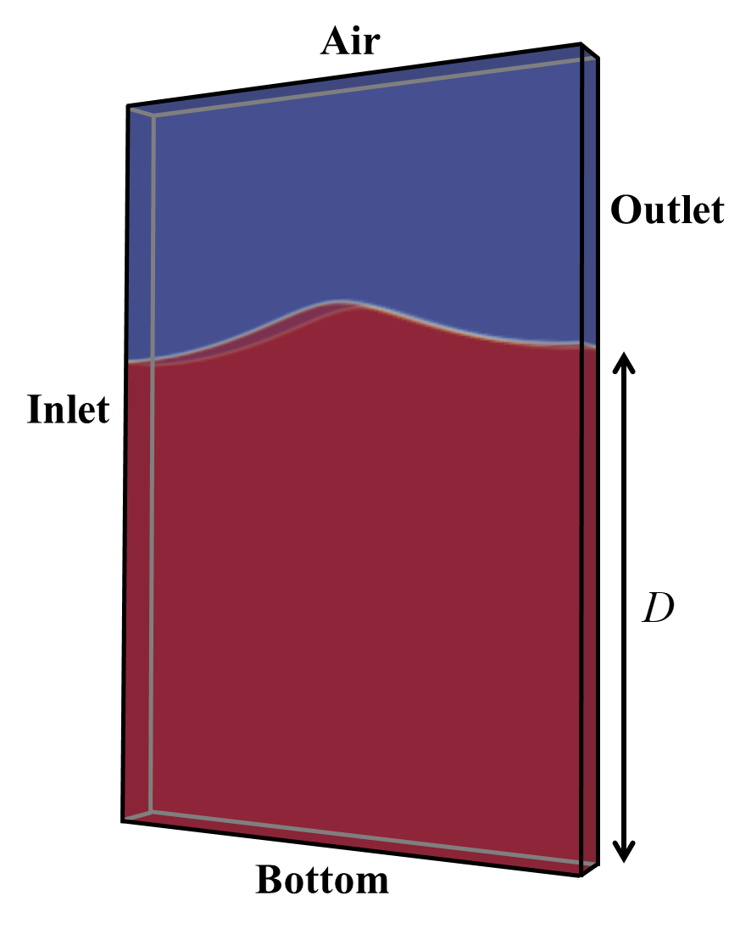
What makes the problem complicated?
Two-phase incompressible viscous (Newtonian) flow solver.
There are many important issues.
The most critical thing is the interface (discontinuity).
Governing equations
Body
VOF, density, mass flux, dynamic pressure, viscosity
Notes:
Why do we need improved solver?
Discontinuous interface : convection of discontinusous properties is wave propagation : free surface piercing body :: it makes the problem complicated.
So, one of my preliminary study focus on the interface treatment schemes.

Slide 5
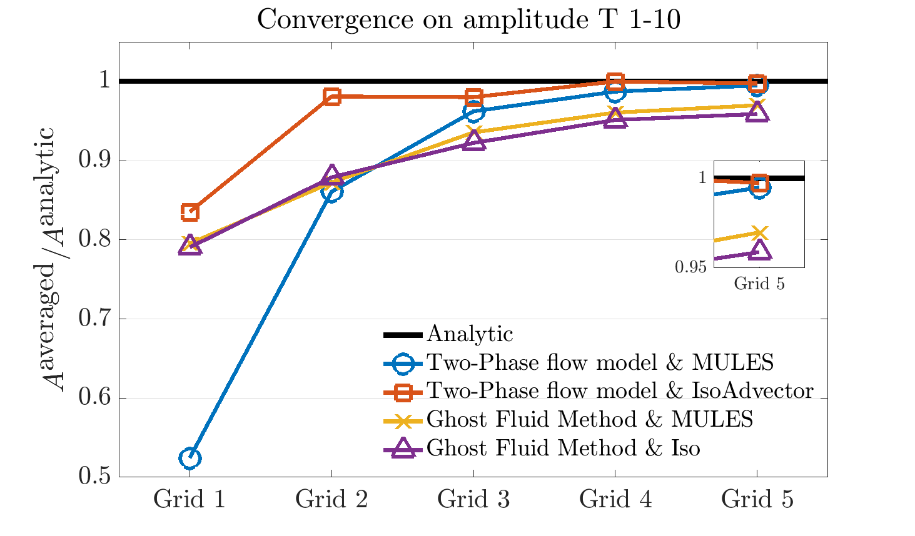
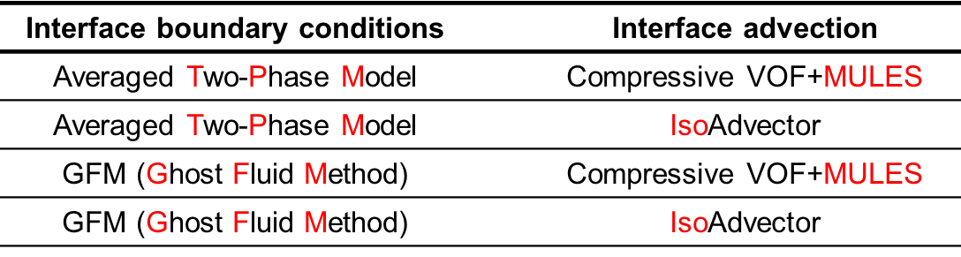
Preliminary study: Interface treatment
The interface treatment schemes
Interface capturing scheme:
Interface advection scheme:
Interface boundary condition:
How to define(capture) the free surface.
How to move interface in time.
How to define the physical properties at the interface.
Periodic wave propagation test
The interface capturing scheme is VOF.
Finer grid
Ref
Ref
Notes:
Two interface advection scheme
Two interface boundary condition
The plot shows normalized averaged amplitide in period 1-10 respect to grid resolution.
As the grid number increase we have finer mesh.
GFM has numerical damping, Isoadvector have good conservation of wave amplitide but it is little unstable.
The reference solver is not always good, but it shows a predictable results.

Slide 6
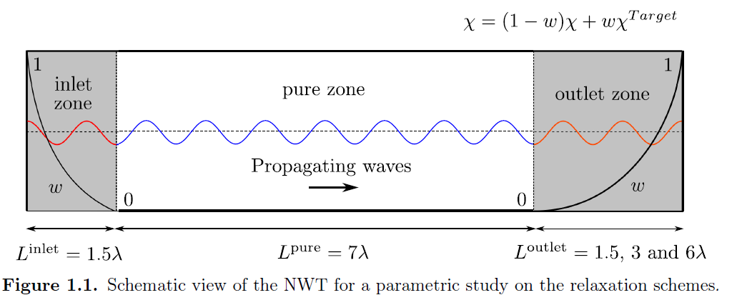
Preliminary study: Waves
Wave generation and absorption.
Explicit Relaxation method is used to generate wave.
Various outlet conditions are studied
Increased viscosity & artificial damping source
Relaxation to incident wave & no wave (calm water).
Mesh streatched outlet
Notes:
Another preliminary study is on ...
In foamStar we use explicit relaxation method to generation and absorption waves
To validate this other wave absorption methods are studied.

Slide 7
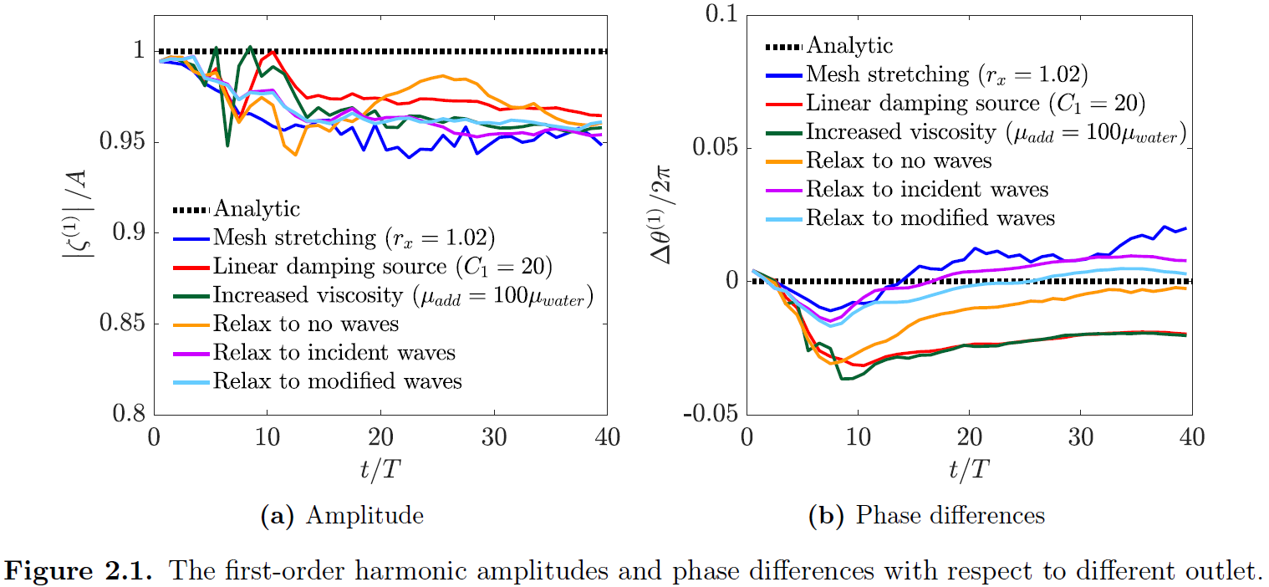
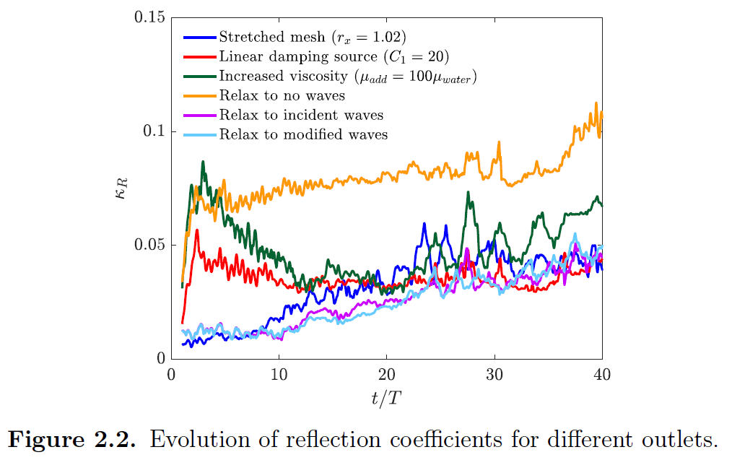
Preliminary study: Waves
Wave generation and absorption.
If the condition of outlet is different to the incoming wave, it makes wave reflection and phase shift.
If without body, Indicent wave outlet condition gives most stable and precise wave propagation.
Notes:
We have two conclusion.

Slide 8
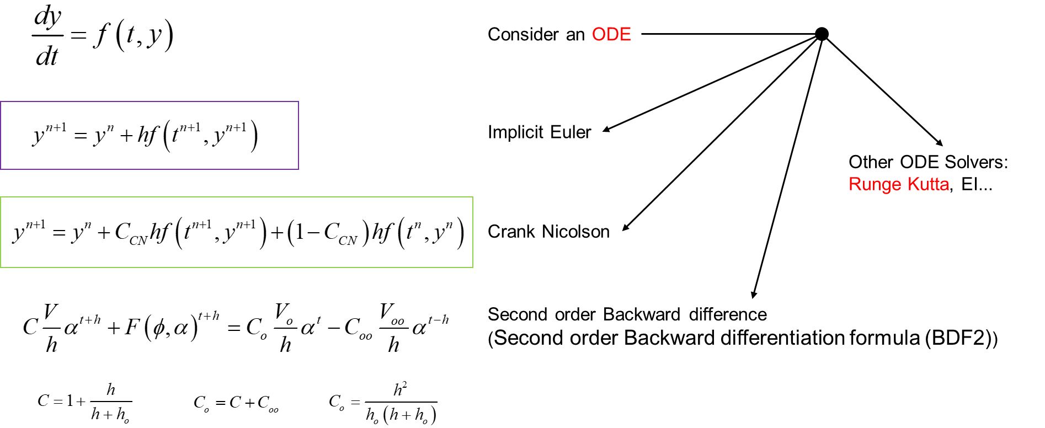
Numerical Improvement Higher-order schemes
Higher-order scheme.
The higher-order schemes are believed to have the advectage on high-order accuracy
Spatial scheme
Temporal scheme
Algorithms and its applications are complicated.
The temporal schemes are studied first, beacuse it is more simple.
Notes:
I choose higher-order scheme as a numerical improvement.
The higher-order schemes are believed to have the advectage on high-order accuracy.
So I have to do both HO spatial and HO temporal discretization scheme.
Consider a ODE
If mesh do not move, the problem is 1D in time.

Slide 9
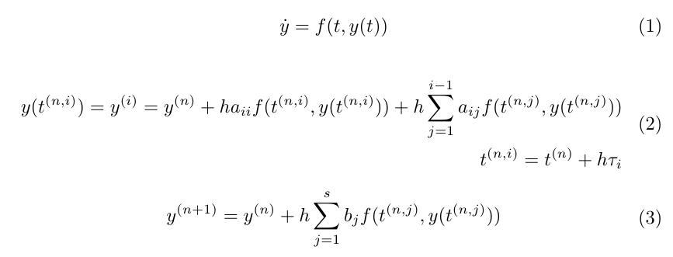
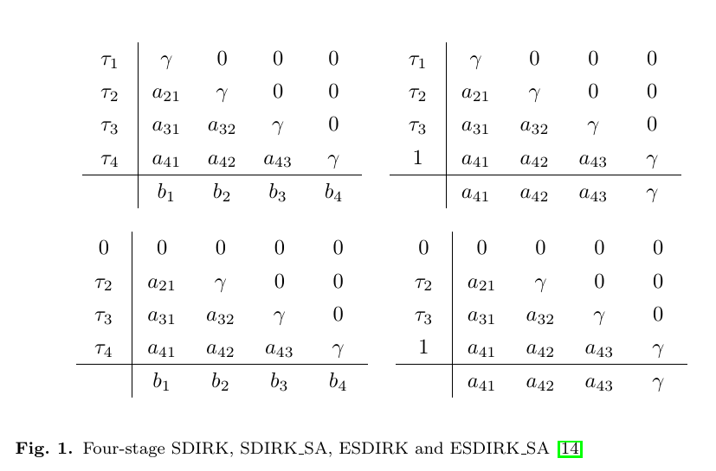
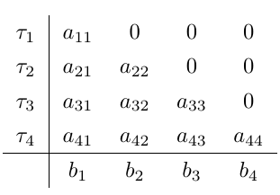
Higher-order temporal schemes
Diagonally Implicit Runge-Kutta (DIRK) method
Only SA DIRKs are used.
ODE
Singly Diagonally IRK
SDIRK Stiffly accurate
Explicit
Diagonally implicit
Explicit first SDIRK
ESDIRK SA
Butcher matrix
Notes:
Only SA DIRKs are used bacuase it is more stable.
SA prevent to solve eq(3) which help not to use explicit limiter again in the VOF convection equation.

Slide 10
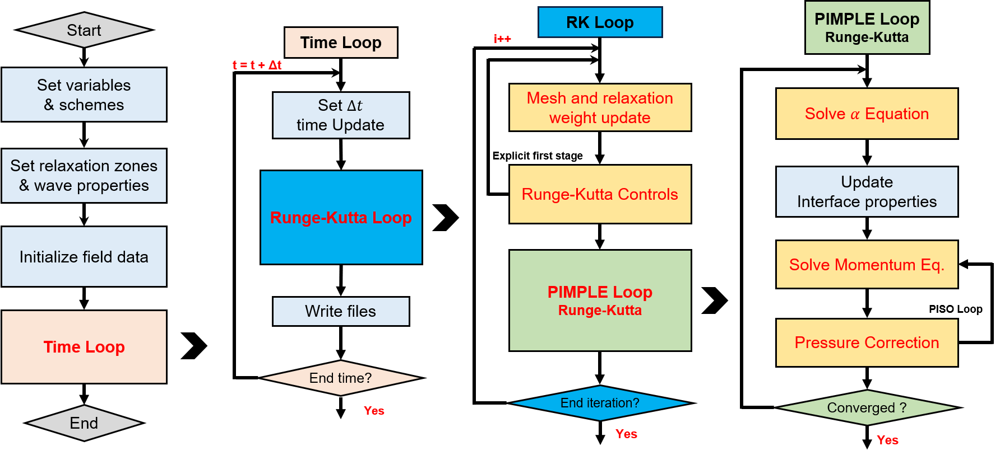
Higher-order temporal schemes
Explicit term
Previous RK iteration data must be used.
Thus, each governing equations must change.
Notes:
Full algorithm
The RK loop will place upon the PIMPLE loop.
So, this means if i use 2 stage DIRK scheme, the compuational time will be double.
Also, inside the PIMPLE loop each governing equaiton should change a little due to the explicit term.

Slide 11
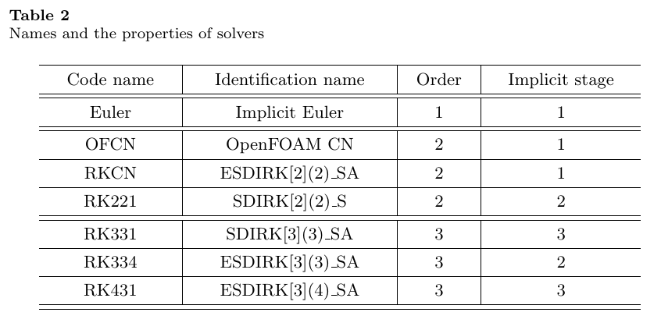
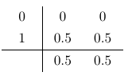
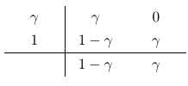
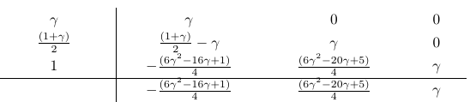
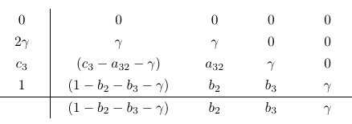
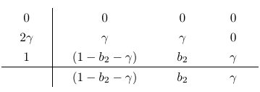
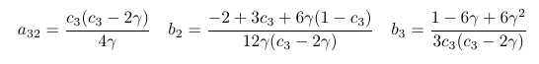
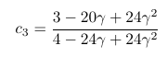
Higher-order temporal schemes
RKCN
RK221
RK331
RK431
RK334
Notes:
RKCN: 2nd order two stage explicit first scheme
Maximum third order is considered.
The detail stability and order properties will be discuss in the paper.

Slide 12
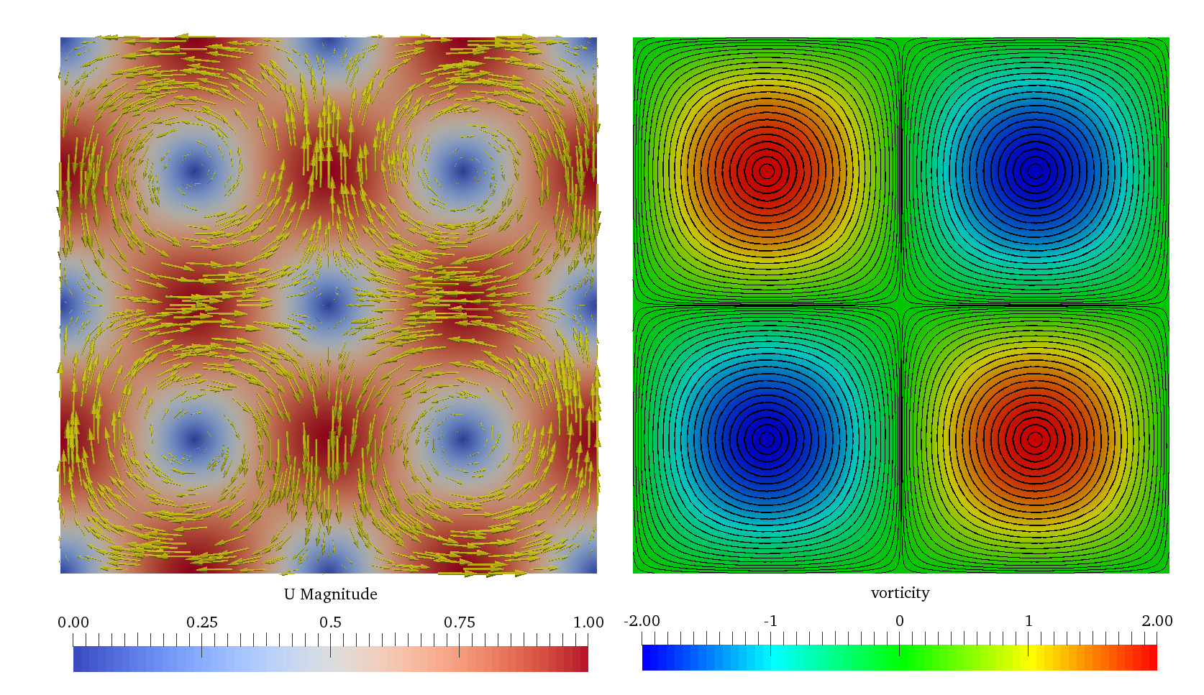
Higher-order temporal schemes
Taylor-Green vortex simulation
Analytic solution
vortisity
Computational conditions
VelocityMag + VelocityVector
Vortisity + Streamline
Notes:
To validate DIRK scheme simple one-phase TGV simulation is done.

Slide 13
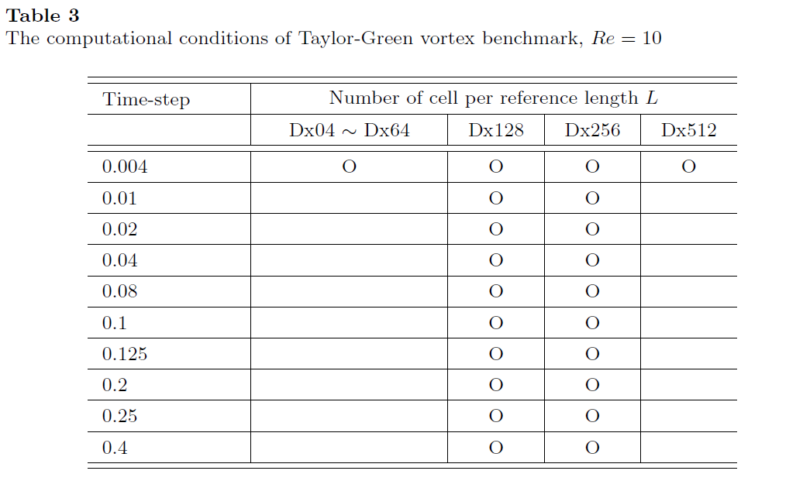
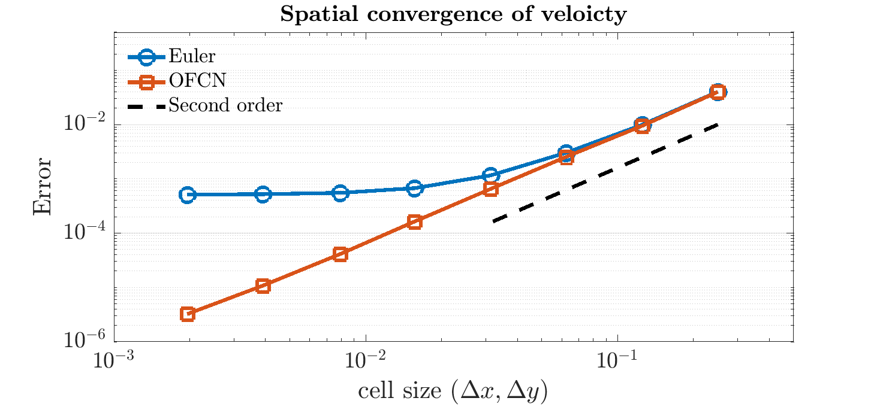
Higher-order temporal schemes
Taylor-Green vortex simulation
maximum error of velocity magintude
maximum error of pressure
Spatial
Spatial Convergence of velocity
All spatial schemes are linear
Temporal error dominant
Spatial error dominant
Temporal
Notes:
The error are measured at t = 2 sec.
The Euler scheme has second order convergence with very course mesh, but the order of convergence decay as the cell size decrease.

Slide 14
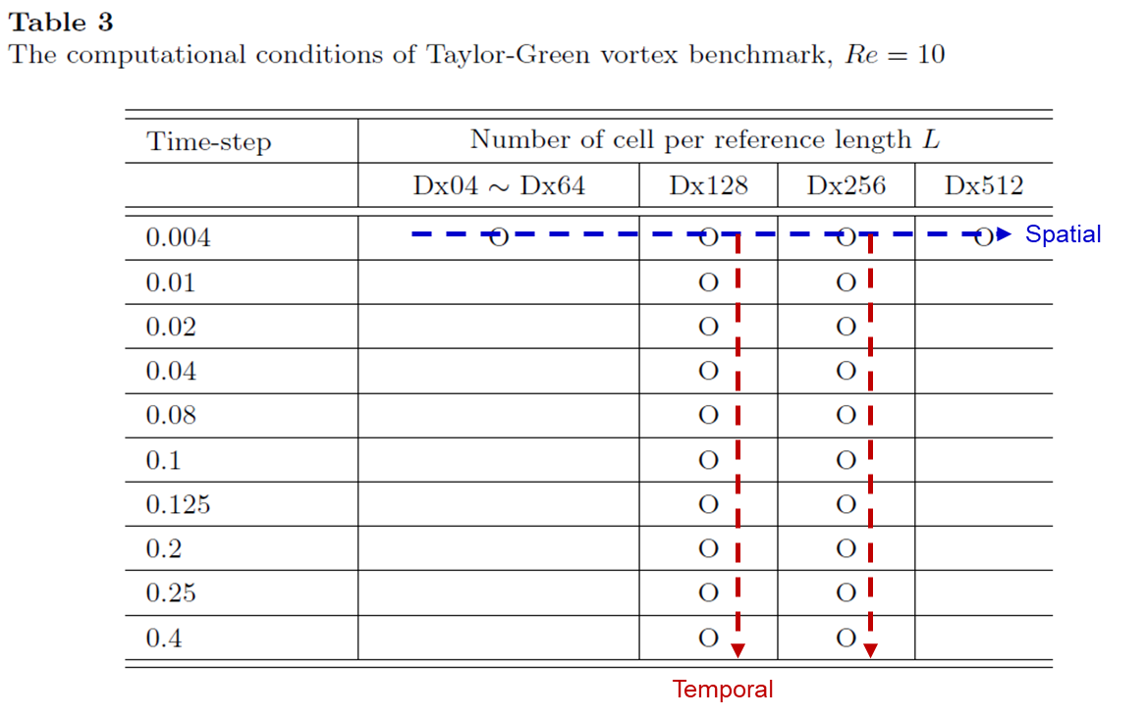
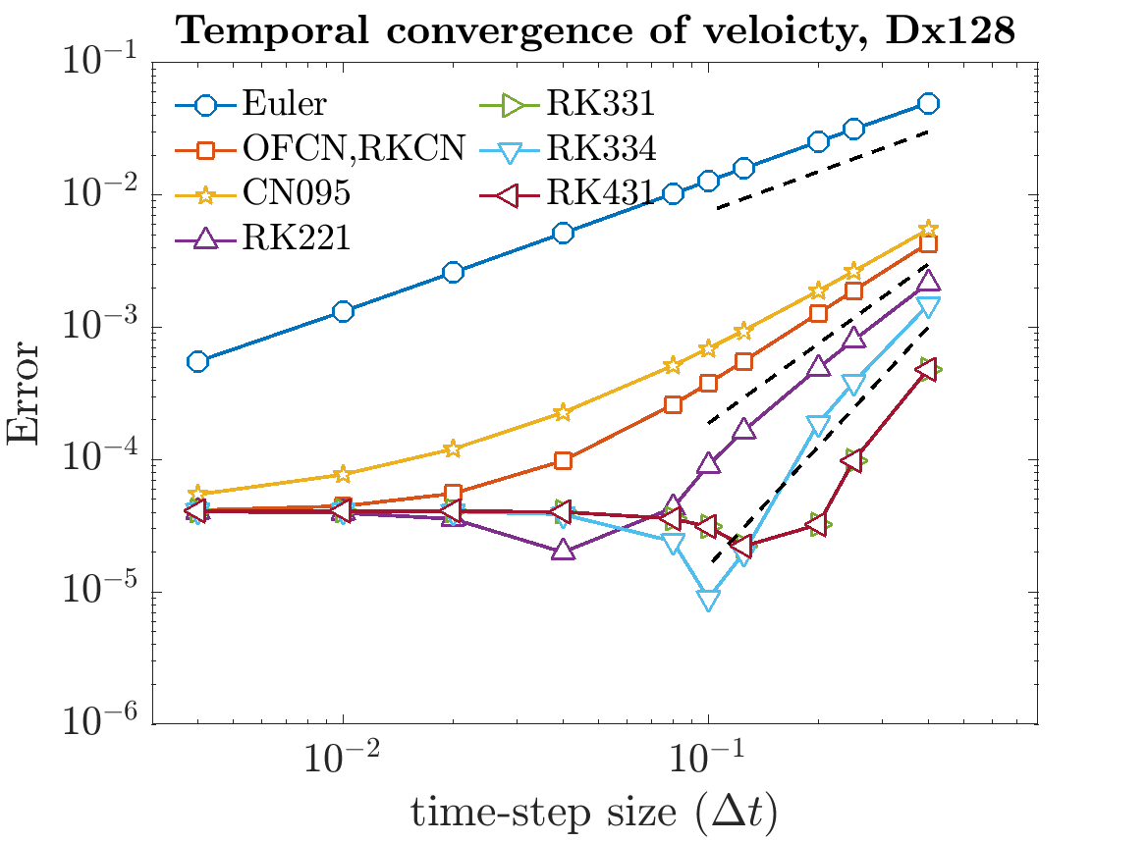
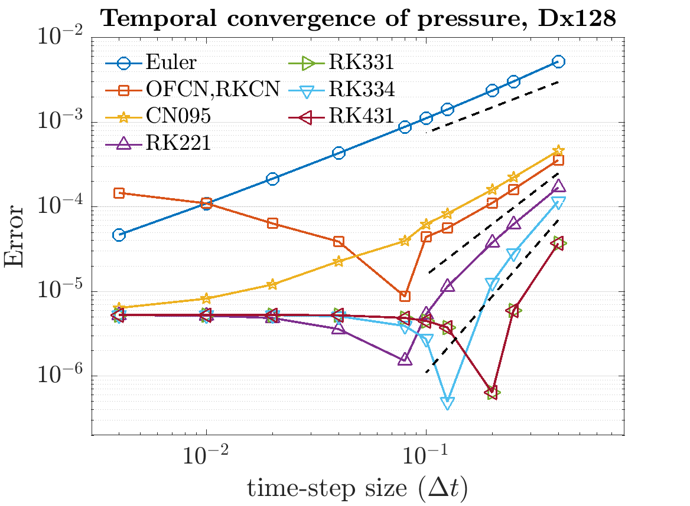
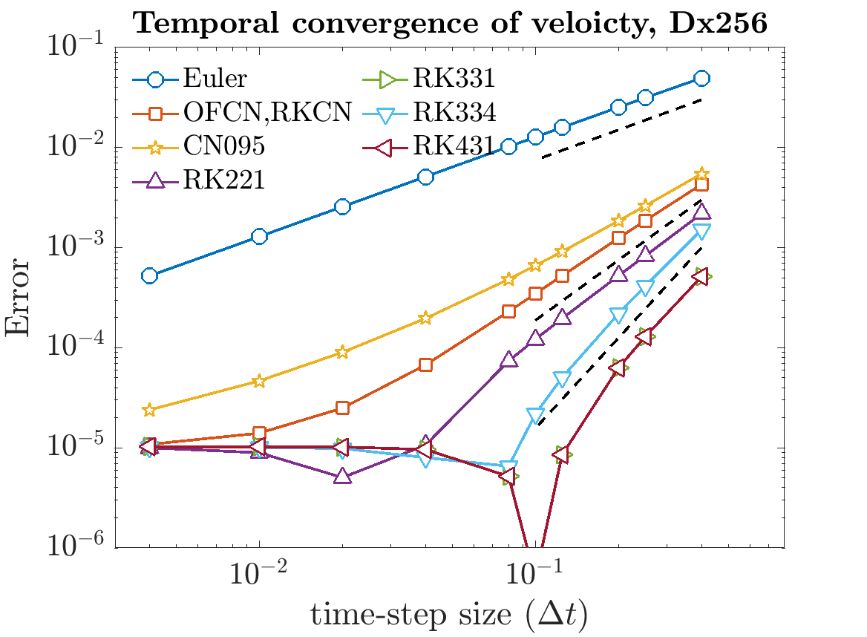
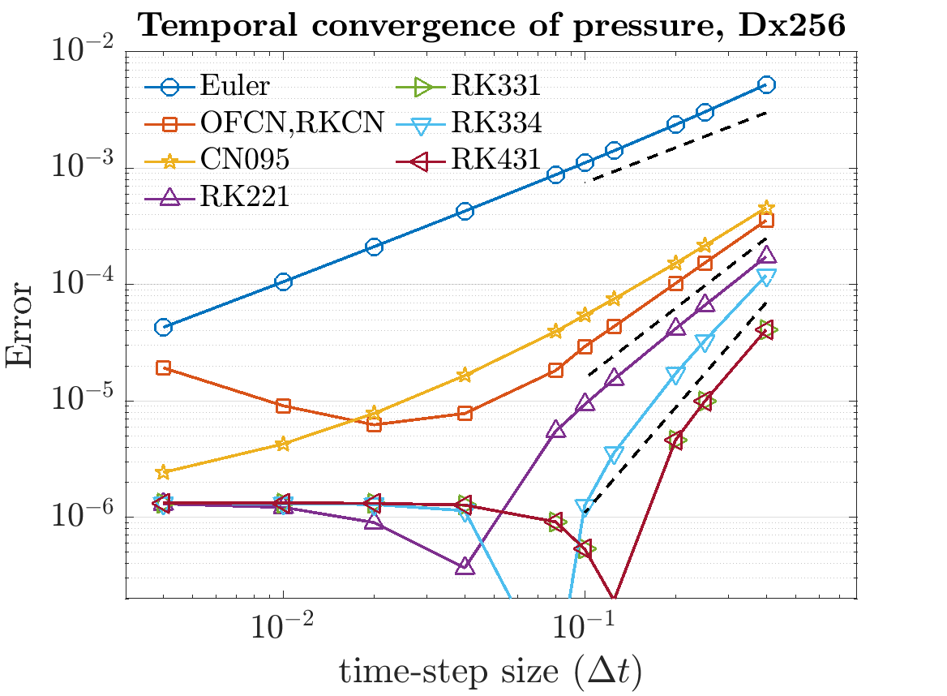
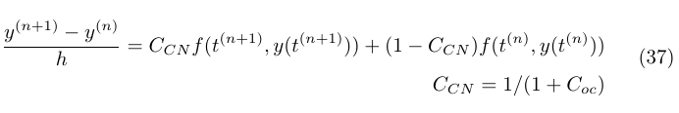
Higher-order temporal schemes
1st
2nd
3rd
Convergence limit due to spatial error
Unstable pressure
This can be remedied using off-centering
But lose the convergence order.
Temporal error dominant condition
The order of convergence is achieved.
Spatial error dominant condition
Convergence limit
Notes:
This slide shows the temporal convergence for grid Dx128 and Dx 256

Slide 15
Higher-order temporal schemes
1st
2nd
3rd
Convergence limit
Notes:
So DIRK method seems to be work properly.

Slide 16
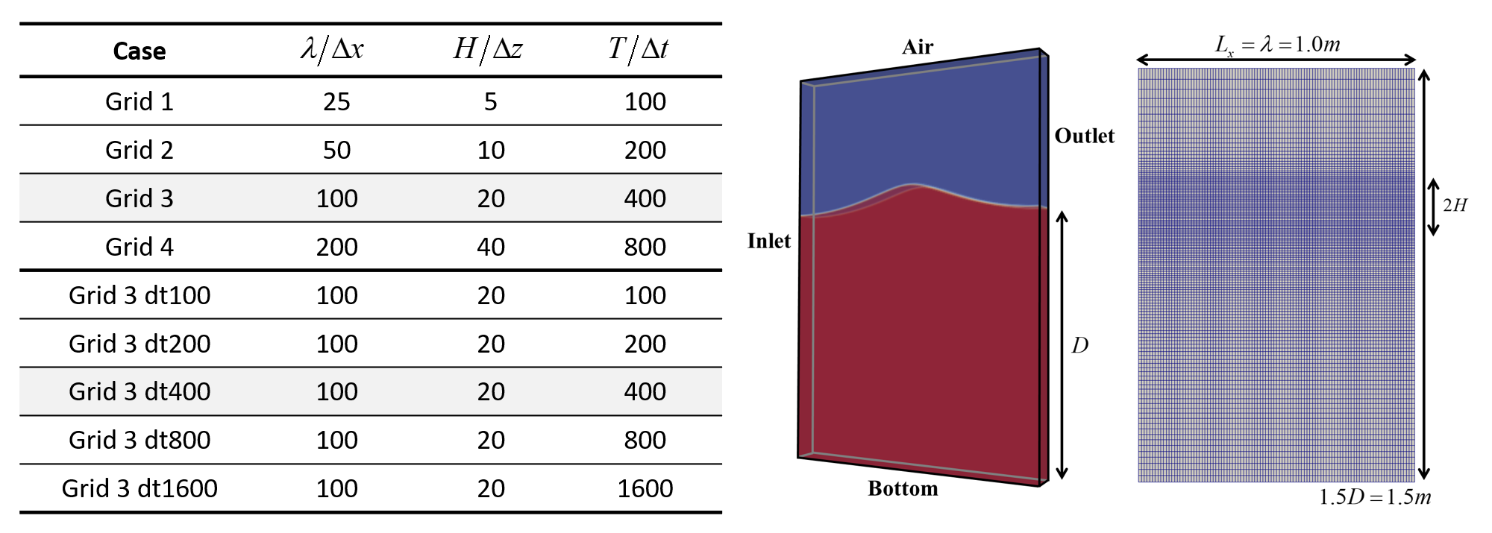
Higher-order temporal schemes
Periodic wave propagation
Reference
Averaged normalized wave amplitude from 1-10 periods
(Computation time) x (nCore)
Notes:
Using Periodic wave propagation, we test the DIRK schemes

Slide 17
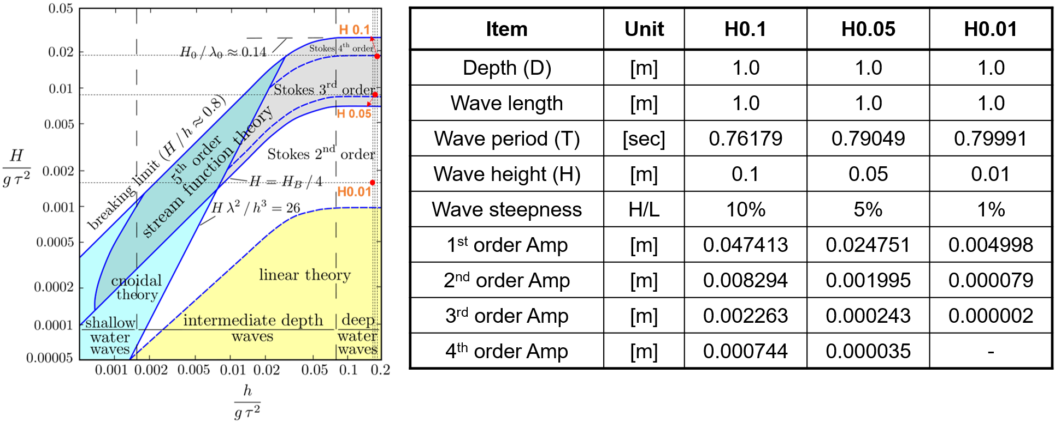
Higher-order temporal schemes
Periodic wave propagation
Averaged normalized wave amplitude from 1-10 periods
(Computation time) x (nCore)

Slide 18
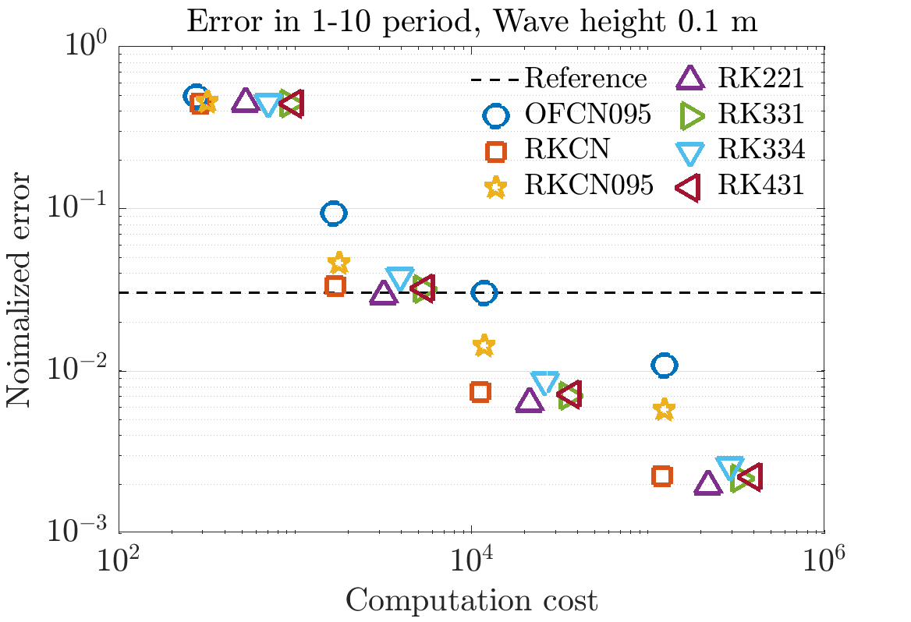
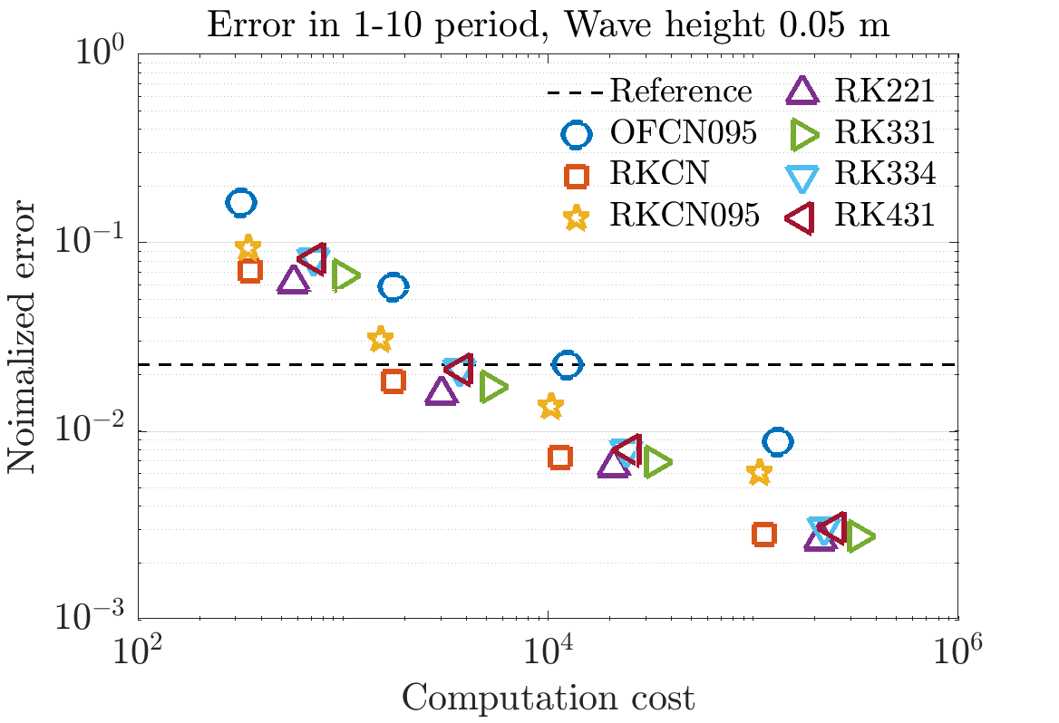
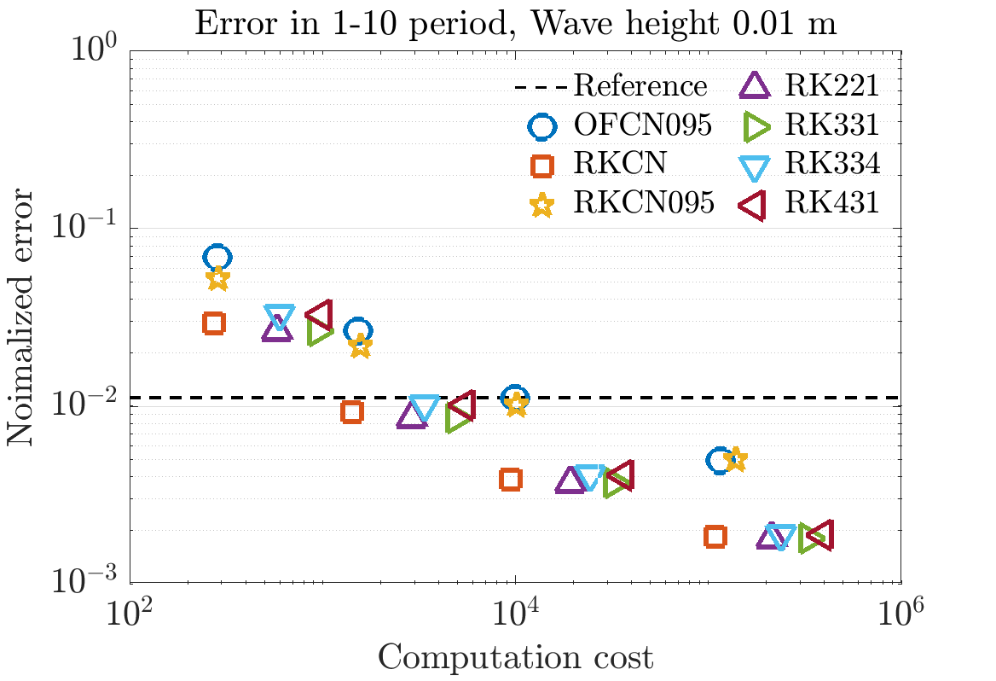
Higher-order temporal schemes
Periodic wave propagation
Grid 1
Grid 2
Grid 3
Grid 4
Efficient
Height 0.1
Height 0.05
Height 0.01
Black dotted line is reference OFCN095 case
Only spatial convergence cases are plotted here to estimate the spatial error.
Notes:
It plots the normalized averaged error respect to computational cost.

Slide 19
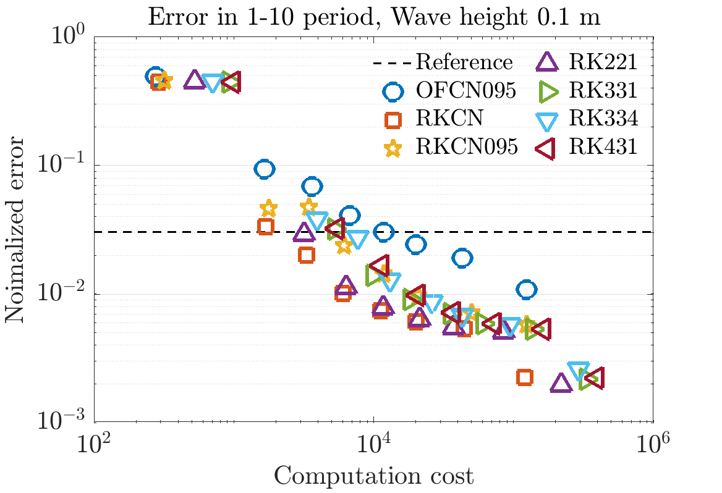
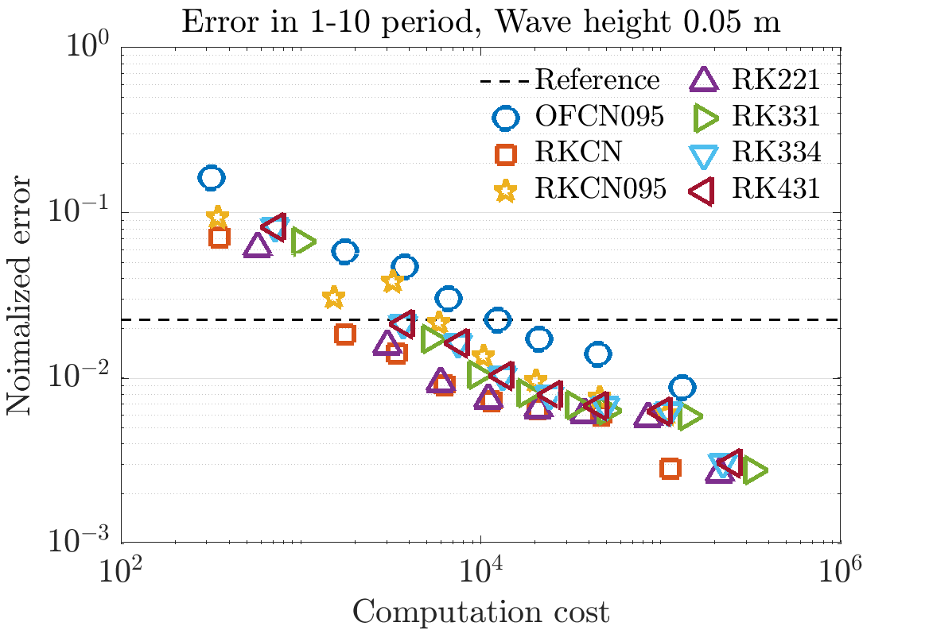
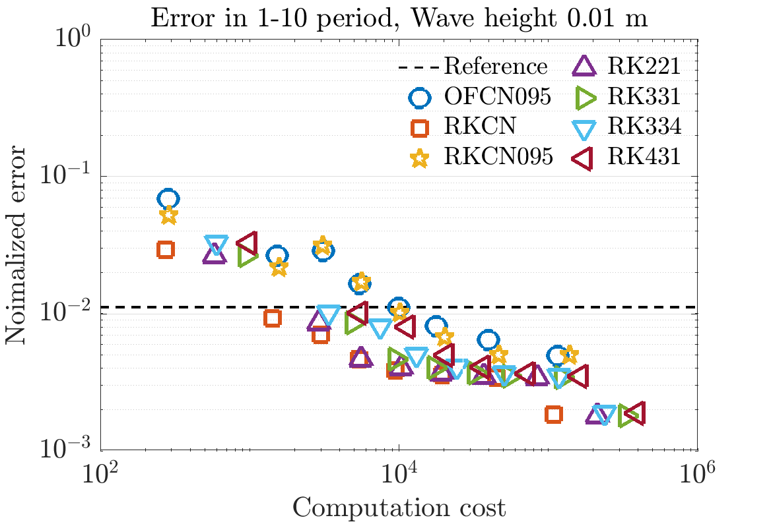
Higher-order temporal schemes
Periodic wave propagation
Efficient
The efficient solvers are RKCN and RK221
Higher-order rate of convergences are not observed.
If the wave amplitudes are small, we can use courser mesh

Slide 20
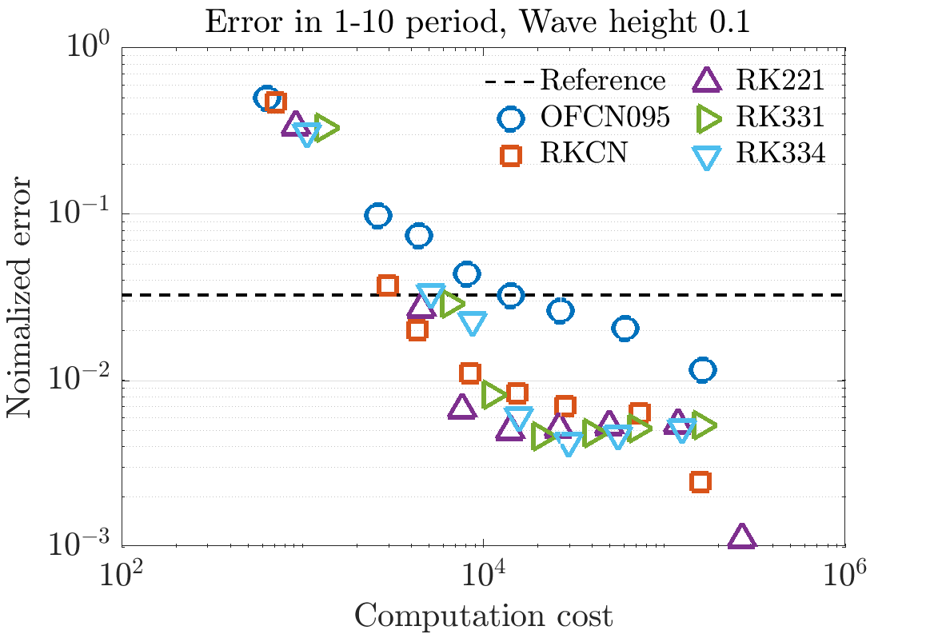
Higher-order temporal schemes
Periodic wave propagation with moving mesh
Imaginary
body
Error increased compare to the static mesh cases
DIRK type methods are more efficient then classical OFCN

Slide 21
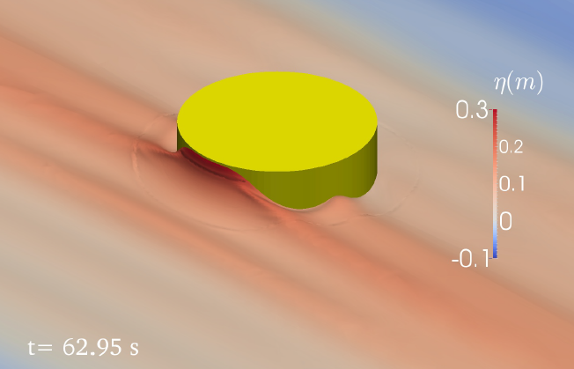
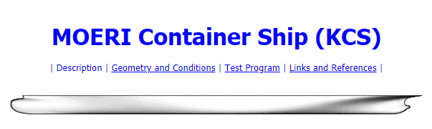
Higher-order temporal schemes
Near future works
To do a FSI simulation it is good to use SWENSE to control the number of the cells.
= incident wave component + complimentary component
1. CALM buoy in regular / irregular wave
2. KCS with waves & forward speed

Slide 22
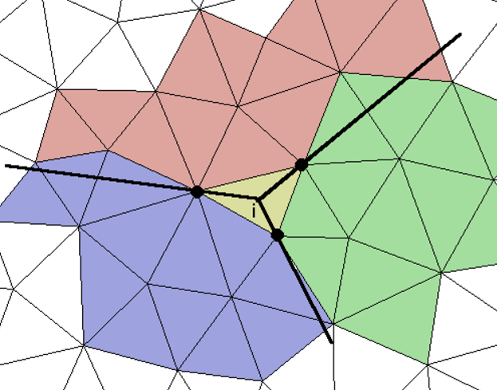
Higher-order spatial schemes
Future works
WENO & WENO reconstruction method.
N_{si}=stencils
Need careful formulation
also needs to estimate its efficiency.
Stencil 1
Stencil 2
Stencil 3

Slide 23

Articles
1. A paper on the higher-order temporal scheme (ongoing).
2. A paper on the interface treatment schemes (Not ready yet).

Slide 24
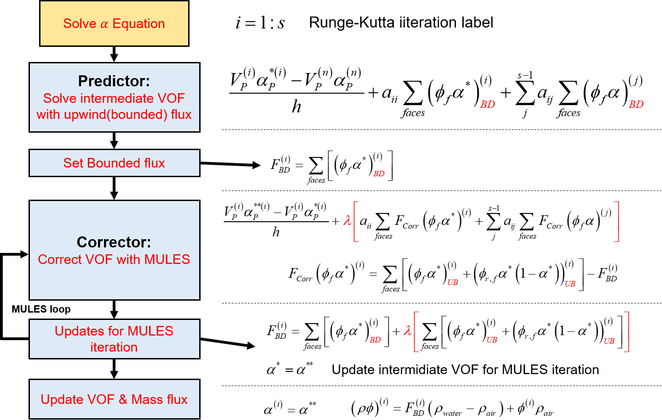
Higher-order temporal schemes

Slide 25
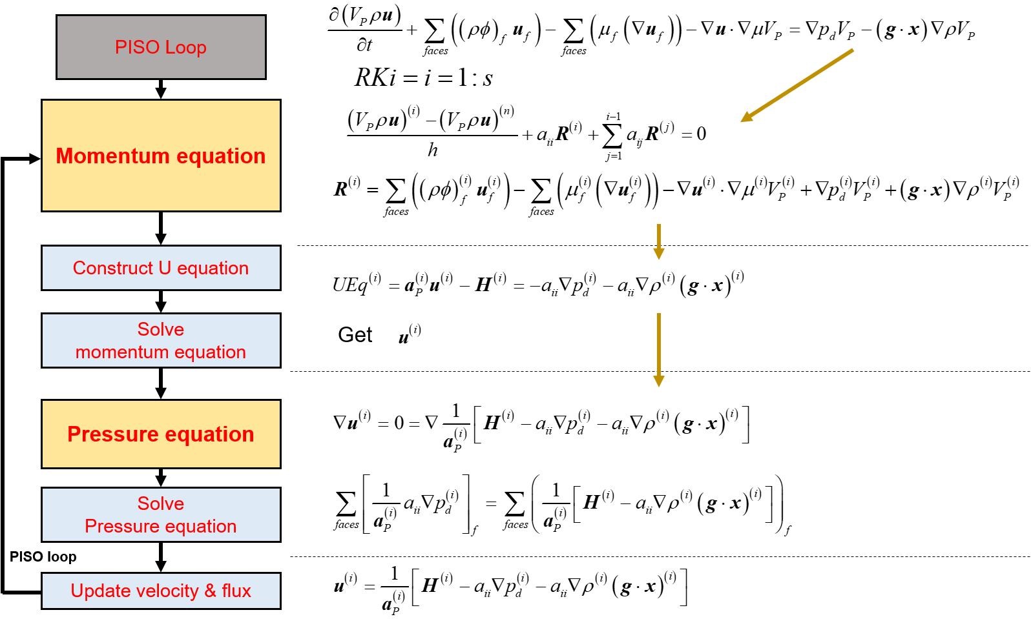
Higher-order temporal schemes

Slide 26
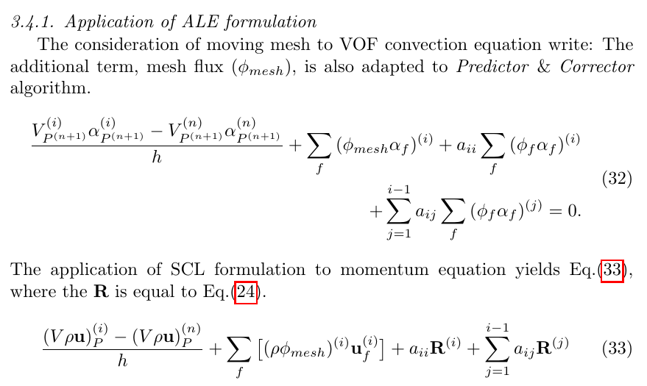
Higher-order temporal schemes: ALE

Slide 27
Preliminary study: Waves
Wave generation and absorption.
Explicit Relaxation method (to incident wave & no wave).
Increased viscosity & artificial damping source

